Slide 1
House Pricing Prediction
Yiming Lai, PhD
Mentored by Wayne Ang
Springboard Data Science Capstone Project

Slide 2
Problem statement
House buying or selling is a long and uncertain process especially for the first time buyers/seller. In this capstone we try to answer the most critical and probably the first question we ask:
For the house buyers:
How much should I bid on the house without overpaying?
For the house sellers:
How much should I label the sale price for the house?

Slide 3
What factors may affect the house pricing?
Others?
- Age of the house, interior/exterior qualities, utilities…etc
Size of the house?
- Living area, lot size
Type of the house?
- Single family, town house, condo…etc
$Total Budget
Location, location, location?
- School district, downtown, rural area…etc

Slide 4
Data information
Data content: Sale price of the individual residential property in Ames, Iowa from 2006 to 2010
Number of record: 1460
Number of features: 79
Source: Kaggle (https://www.kaggle.com/c/house-prices-advanced-regression-techniques), compiled by Dean De Cock

Slide 5
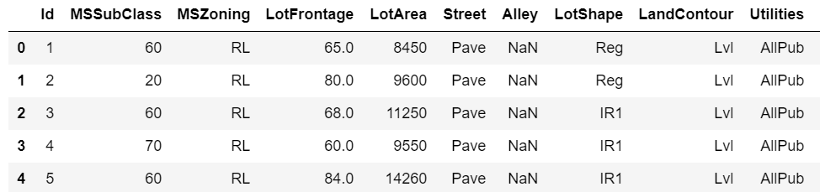
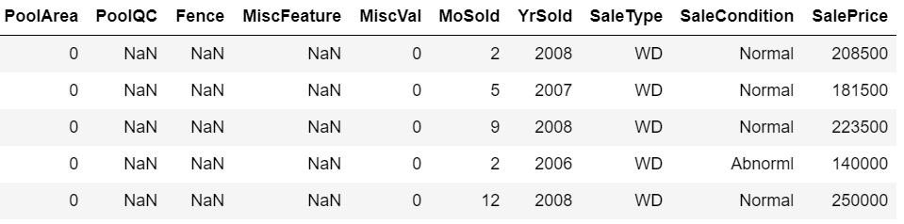
Data engineering
Key steps for data cleaning and wrangling
Remove features PoolQC, MiscFeature, PoolArea, Alley and Fence since more than 80% of data in those features are missing
Replace the missing values in categorical features such FireplaceQu, GarageFinish, etc with None to indicate the house doesn’t have such feature
Replace the missing values in numerical features such as GarageArea, GarageCars with 0 to indicate the house doesn’t have such feature
Replace the missing value in the LotFrontage by the mean value in the specific neighborhood the house belongs to
Replace the rest of the missing values by the most common value in the corresponding neighborhood
Convert the YearBuilt feature to the new feature HouseAge
Quick glance of the data set
……

Slide 6
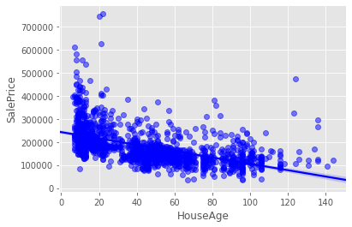
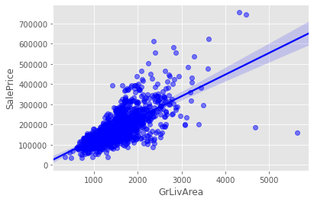
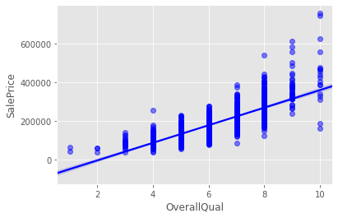
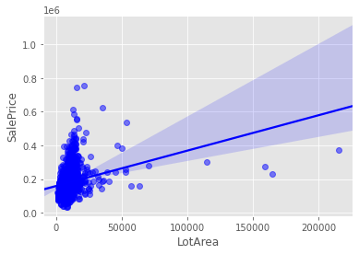
Data exploratory and analysis – Numerical variables
Observations
The sale price is inversely proportional to the age of the house, but the correlation is not strong
In general, the sale price is proportional to the size of the house. Some possible outliers were observed
Better the quality of the overall material and finish of the house, higher the sale price

Slide 7
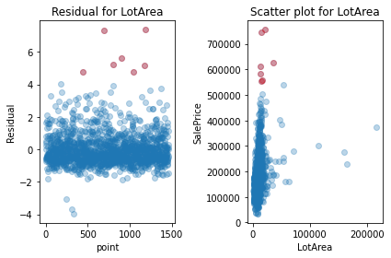
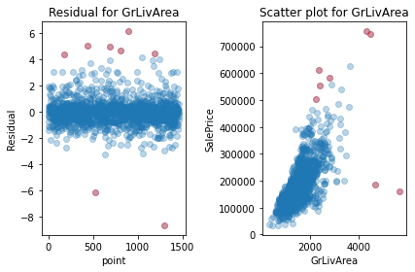
Data exploratory and analysis – Numerical variables
Calculate the studentized residuals and remove the data points that have the corrected p-values less than 0.05

Slide 8
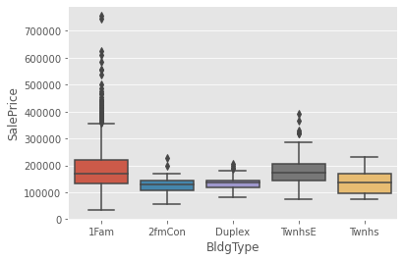
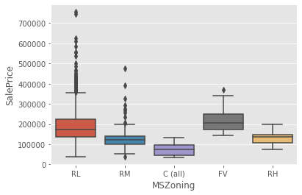
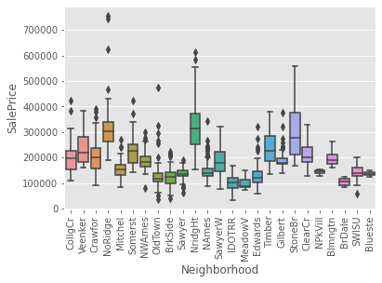
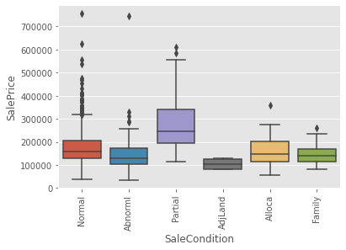
Data exploratory and analysis – Categorical variables
Observations
Not much difference in the sale price between different building type but most of the high price houses are single family houses
The houses in the low density residential area tends to have higher sale price which the houses in the commercial area tends to have lower sale price
The sale price also depends on the neighborhood, which may be correlated to many different factors such as the safety index, nearby schools..etc
Foreclosure and adjoining land purchase are less popular

Slide 9
Modeling – workflow
Feature selection
Log-transform/one hot encoding/scaling
Model training, hyperparamter tuning (scikit-learn), prediction
Train-test split

Slide 10
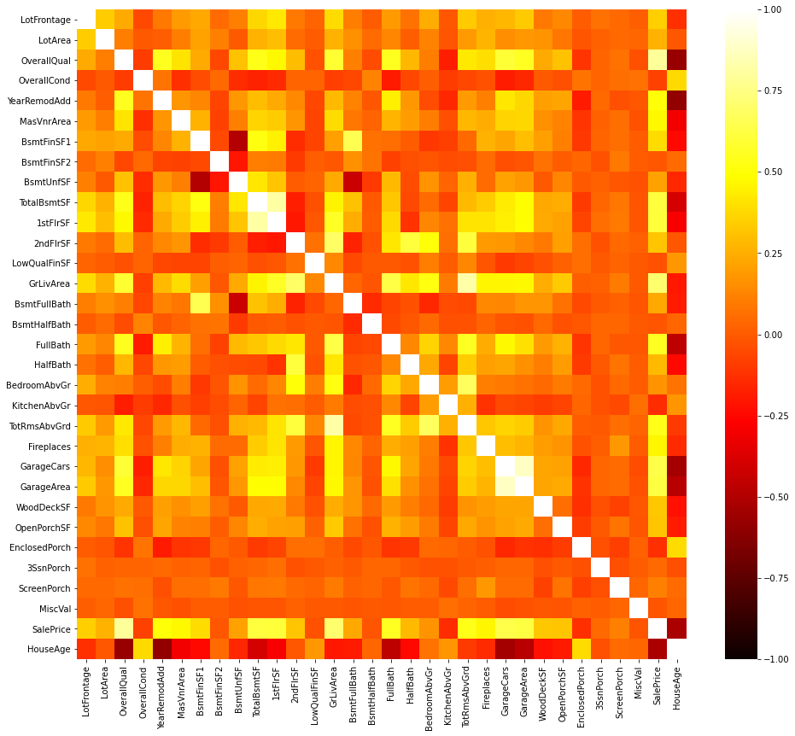
Feature selection – Numerical variables
ρ = 0.82
ρ = 0.88
Remove 1stFlrSF and GarageArea
Only keep the features that have > 0.1 correlation with the sale price

Slide 11
Feature selection – Categorical variables
Select categorical features
Divide the sale price into 5 different categories: ['very low','low','medium','high','very high’]
Perform Chi-Squared test and only keep the features that have p-values < 0.05

Slide 12
Modeling
Base models
Ridge regression – Linear regression with L2 penalty
Lasso regression – Linear regression with L1 penalty
Elastic Net regression – combination of L1 and L2 penalties
Support Vector regression – Robust to outliers
Random Forest – Tree base regression
XGBoost – Gradient boosted tree base regression
Stacking model

Slide 13
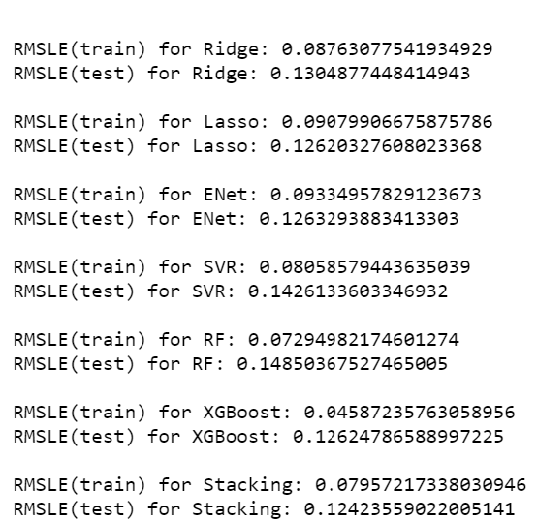
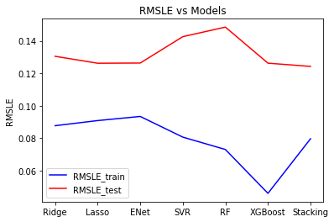
Model comparisons
Use the root mean square loss error as (RMSLE) the figure of merit for our model selection
Stacking model showed the best performance on the training set with RMSLE ~ 0.124

Slide 14
More ideas to improve the model in the future
Better outlier detection algorithm besides the simple linear model
Implement the early-stop hyperparameter to prevent overfitting, especially in the tree-based algorithm
Further feature selection such as discarding the features that have 0 importance in the Lasso regressor
Continue updating the latest data into the dataset

Slide 15
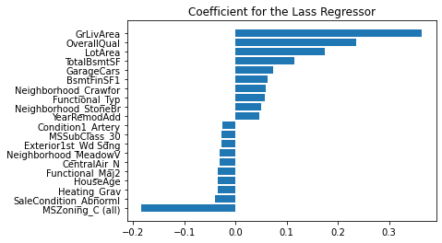
Conclusion
The important features that determine the sale price agree with our general consensus
The most important features for the sale price is the size of the house with 4 out of top 5 positive contributors related to the size of the house
The condition of the house is also important to the sale price
To my surprise, the location of the house doesn’t add too much value to the sale price but since our dataset was collected only in Ames city, the importance of the location might be under-estimated

